Slide 1
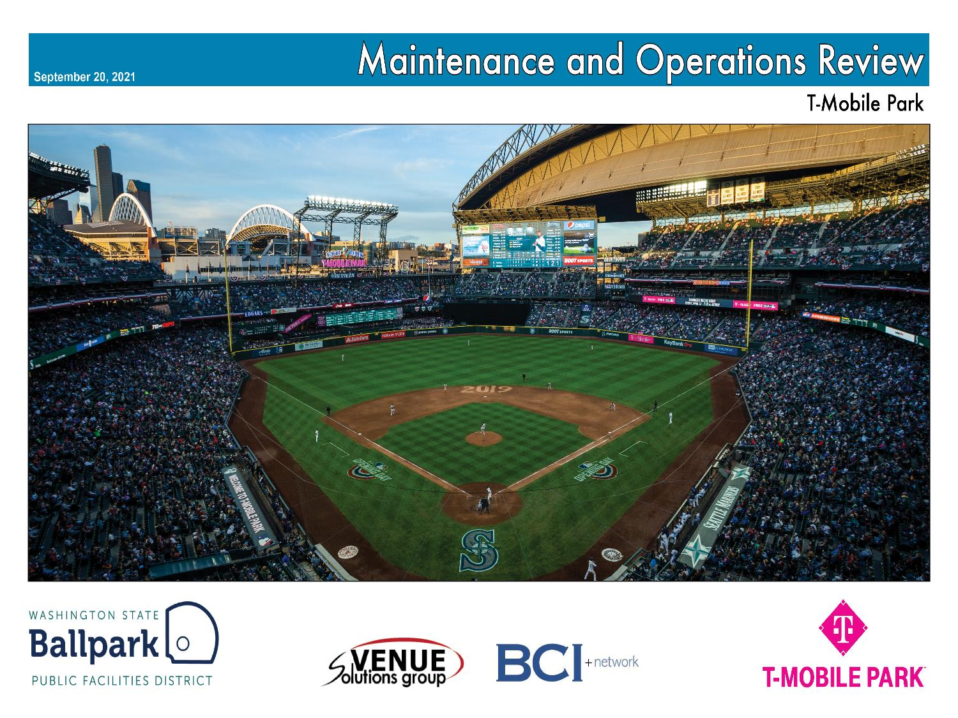




T-Mobile Park Operational Assessment

Slide 2
T-Mobile Park Maintenance & Operations Review
Review Team
Mike Wooley
Venue Solutions Group
John Christison
BCI+network

Slide 3
T-Mobile Park Maintenance & Operations Review
Scope of Work
Review overall condition of ballpark to include cleanliness and wear and tear
Review organization of back of house spaces
Review level of documentation for operating procedures including those for operating during the Covid-19 pandemic
Review application of work order and preventive maintenance program (CMMS)
Provide professional judgment as to the operator's adherence to the Operating Standard
Provide professional judgment as to the operator's adherence to the Operating Plan
Provide PFD observable difference or deviations from the Operating Plan or Operating Standard
Provide recommendations on potential operating improvements

Slide 4
T-Mobile Park Maintenance & Operations Review
Review Process
Documents review
1 ½ days to assess overall condition of the ballpark
Interviews with Ballpark Operations Staff
Interview with the Public Facilities District Staff
Observed during Mariners game with Royals on 9/26

Slide 5
T-Mobile Park Maintenance & Operations Review
Key Findings
Mariners meeting their obligations to PFD as set forth in Lease
Ballpark in excellent condition for its age
Overall, maintenance and upkeep reaches a high level of quality & care
Mariners have long term plan for capital investment
Mariners have a professional staff to maintain ballpark going forward
There are areas of improvement that can be made going forward
Covid-19 impacts on staffing especially on game day

Slide 6
T-Mobile Park Maintenance & Operations Review
Additional Report Highlights
Much of the food service equipment is original and failing at a greater rate
Maintenance of food service equipment shifting to ballpark operations
Additional maintenance position being added for food service repairs
Mariners and Centerplate have plan to upgrade experience
Operations transitioning to a new CMMS to improve operating efficiencies
Operations emphasizing more written policies and procedures
Turnover in operations staff hasn't impacted overall condition of the ballpark

Slide 7
T-Mobile Park Maintenance & Operations Review
Additional Report Highlights
Bowl seating in good condition for 22 years but nearing end of life
Original fixtures and finishes in public restrooms are wearing out
but well maintained
Premium finishes will need refurbishes in the next few years
Exterior concrete repairs have been significant due to subsidence
Garage storage is in the view of the public but mostly secured

Slide 8
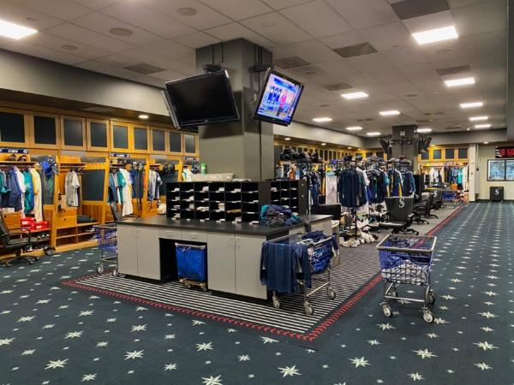
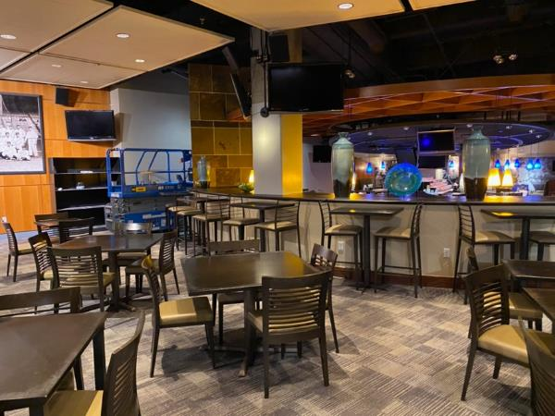
T-Mobile Park Maintenance & Operations Review
Service Level

Slide 9
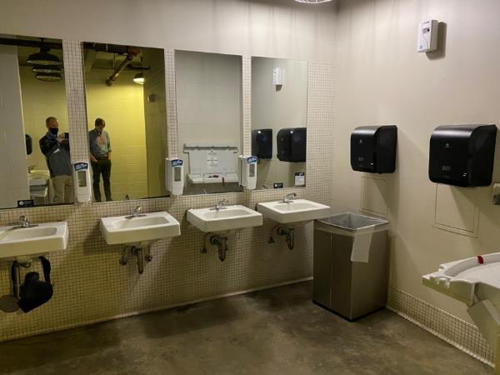
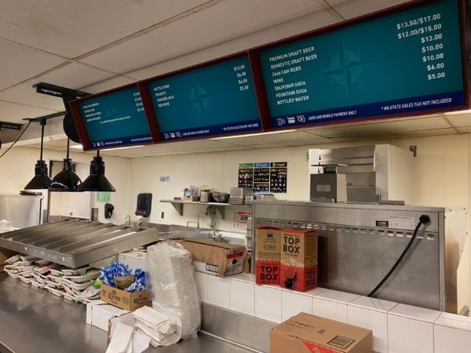
T-Mobile Park Maintenance & Operations Review
Main Concourse

Slide 10
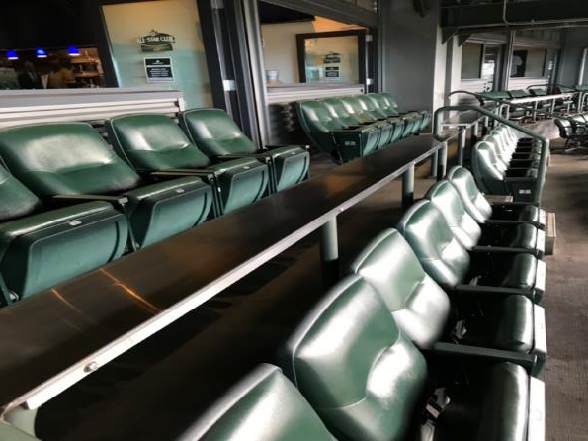
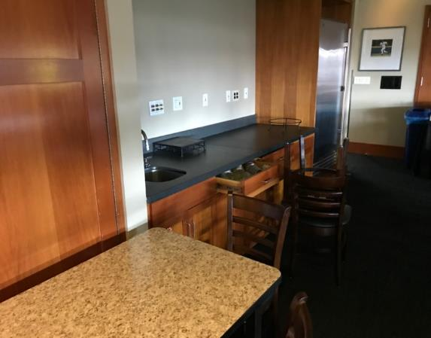
T-Mobile Park Maintenance & Operations Review
Suite Level

Slide 11
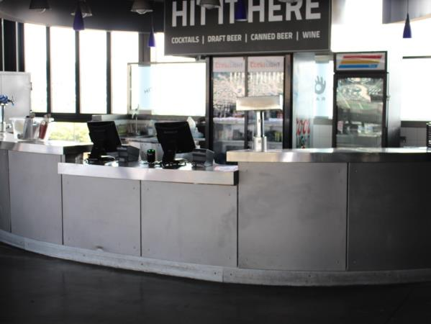
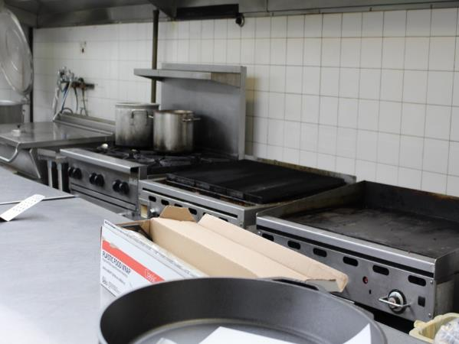
T-Mobile Park Maintenance & Operations Review
Terrace Level

Slide 12
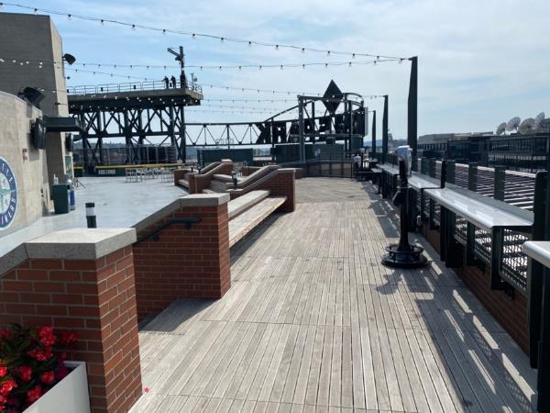
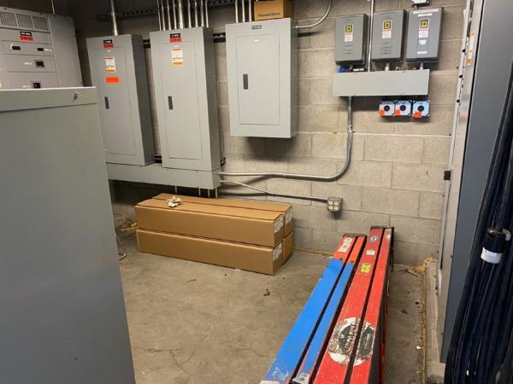
T-Mobile Park Maintenance & Operations Review
Upper Concourse

Slide 13
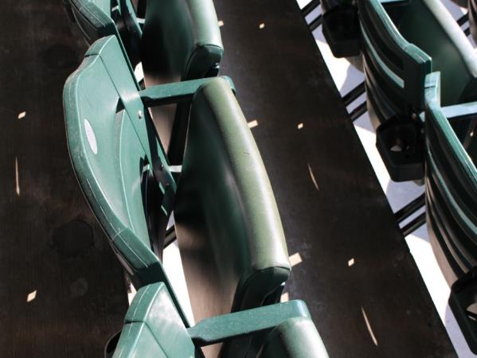
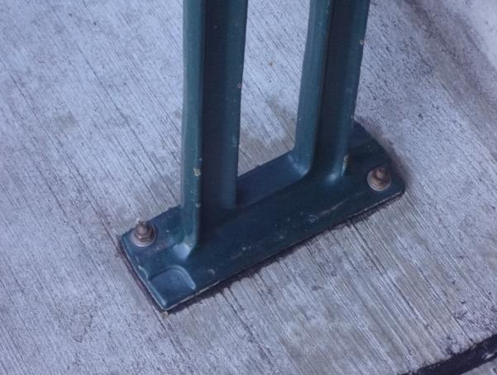
T-Mobile Park Maintenance & Operations Review
Seating Bowl

Slide 14
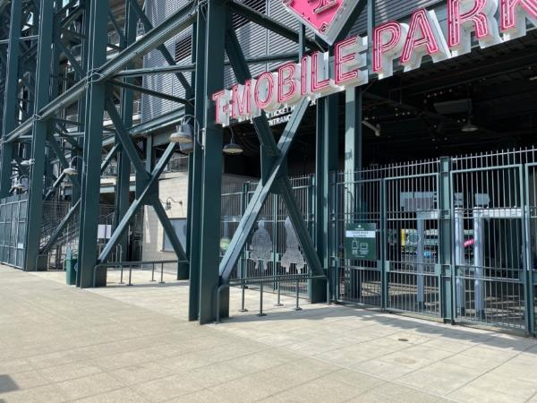
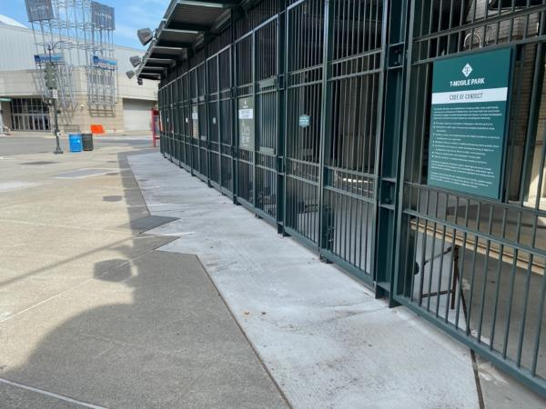
T-Mobile Park Maintenance & Operations Review
Exterior

Slide 15
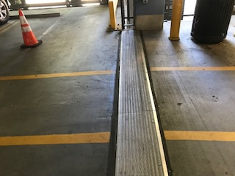
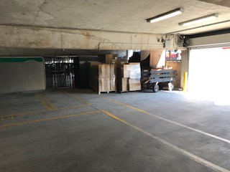
T-Mobile Park Maintenance & Operations Review
Garage

Slide 16
T-Mobile Park Maintenance & Operations Review
Key Findings
Mariners meeting their obligations to PFD as set forth in Lease
Ballpark in excellent condition for its age
Maintenance and upkeep reaches a high level of quality & care
Mariners have long term plan for capital investment
Mariners have a professional staff to maintain ballpark going forward
There are areas of improvement that can be made going forward
Covid-19 impacts on staffing especially on game day

Slide 17
Questions
T-Mobile Park Maintenance & Operations Review

