Slide 1
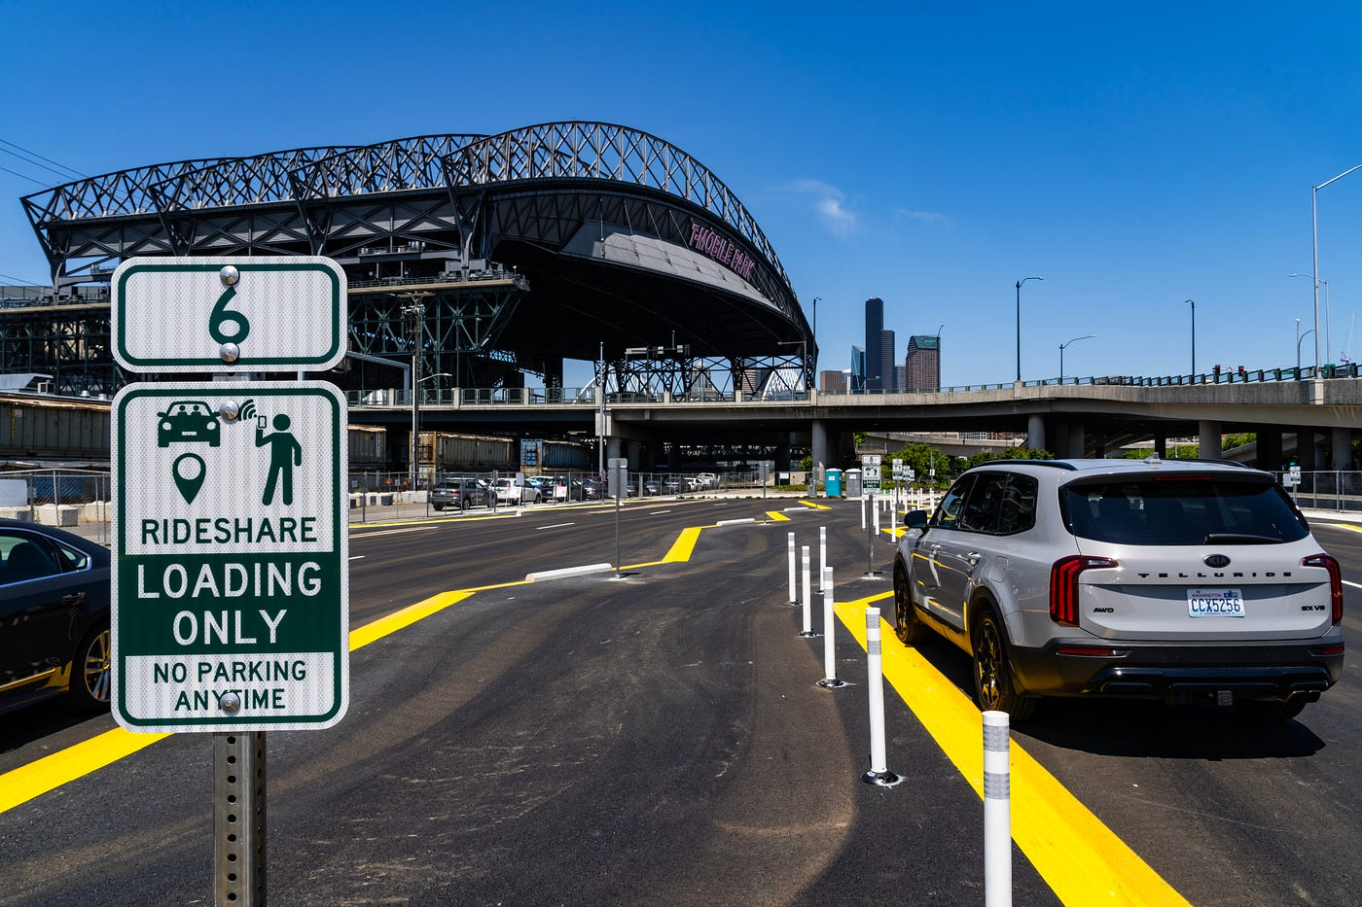
Rideshare Lot: Mariners Games
2023
2024
Average # of Cars:
99
Highest # of Cars:
211 (Mon, Sep 11th vs LAA)
Days of Operation:
21
Average # of Cars:
55
Highest # of Cars:
145 (Thu, Mar 28th vs BOS)
Days of Operation:
22

