Slide 1
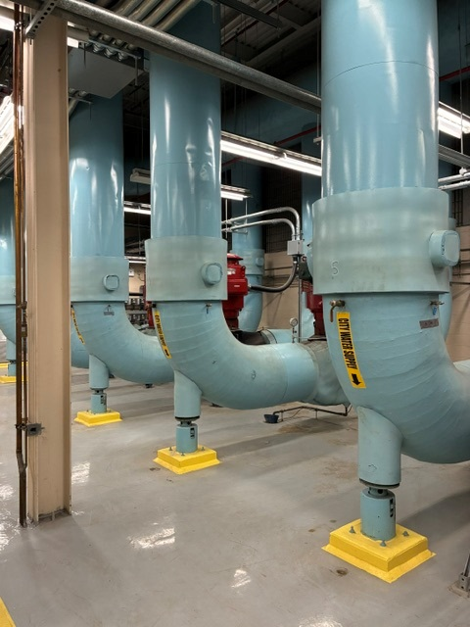

District Energy Tour
Toronto
July, 2026

Slide 2
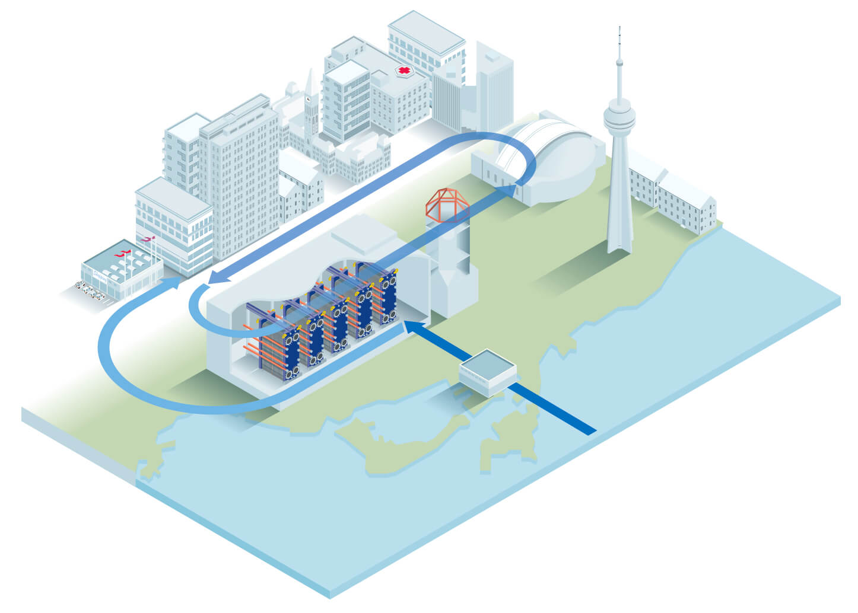
Overview
Deep Lake Water Cooling System
  World’s largest lake-powered cooling system
  Partnership between City of Toronto and Enwave Energy Corporation
  Cooling + potable water

Slide 3
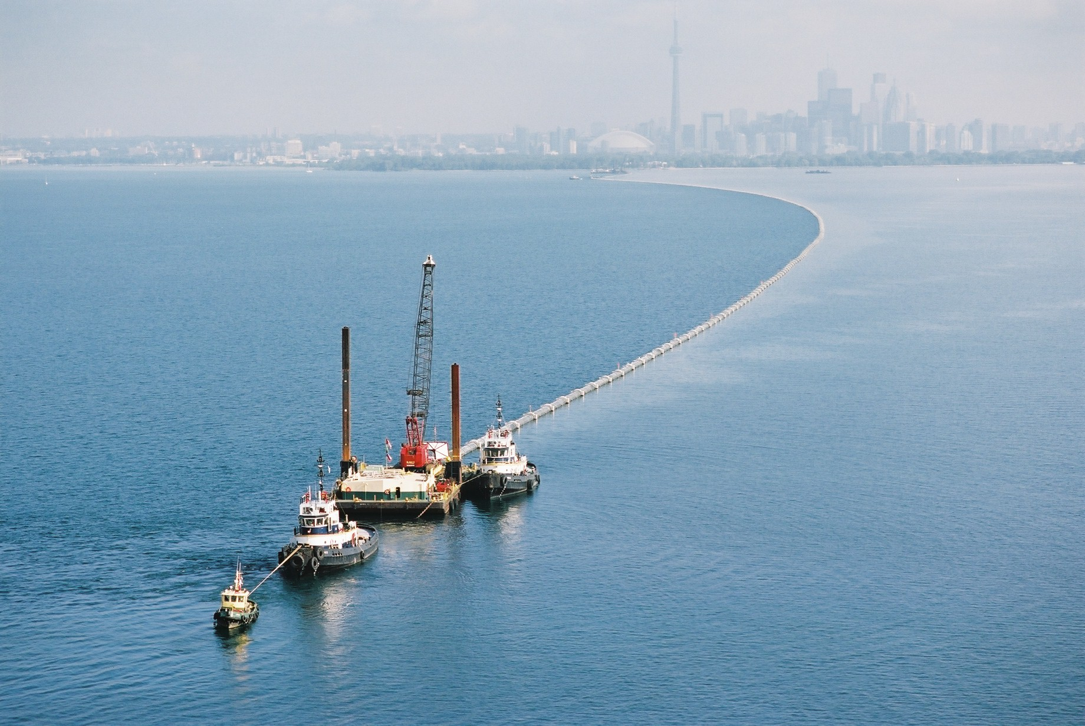
Description
Deep Intake:
Pipes placed 3.2 miles out into Lake Ontario pull water from 280 feet Consistent temperature of 39°F year-round.

Slide 4
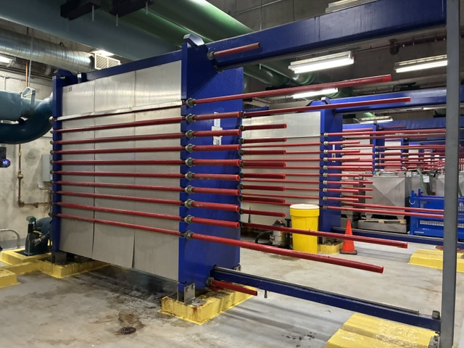
Description
Closed Loops & Heat Exchangers
Cold lake water runs through heat exchanger, transferring thermal energy between buildings’ cooling loops and lake water
Lake water then moves on to city’s municipal water plant.

Slide 5
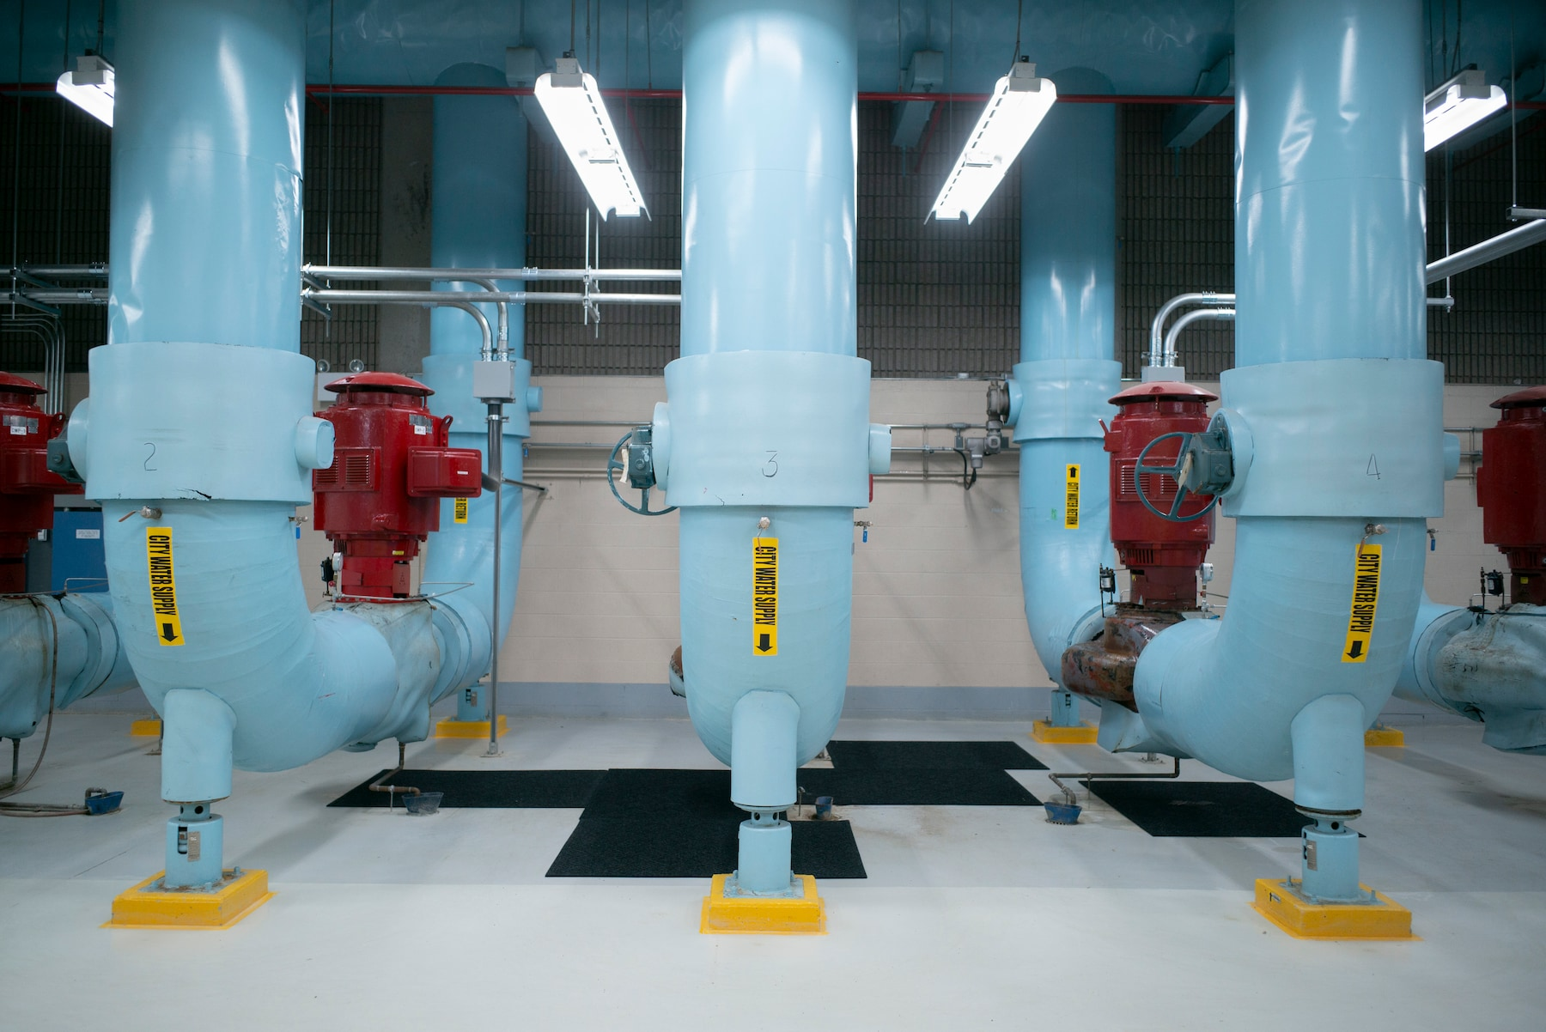
Impact
Key Benefits
Annual savings of 90,000 megawatt-hours (80% to 90% compared to traditional chillers)
Eliminates the need for standard chemical-heavy cooling towers and cuts thousands of tons of carbon emissions every year.

